Slide 1
New Course Requests
Start Request | 2-1
Select Department | 2-2
Select Division | 2-4
Select Effective Term | 2-5
Request Course Data | 2-6
Course Lookup | 2-7
Additional Data | 2-8
Co-requisites | 2-9
Supporting Course Data | 2-11
Scheduling | 2-12
Release or Decline/Cancel | 2-13
Variable Credit Hours | 2-14
Graduate Credit | 2-15
Zero Hour Course | 2-16

Slide 2
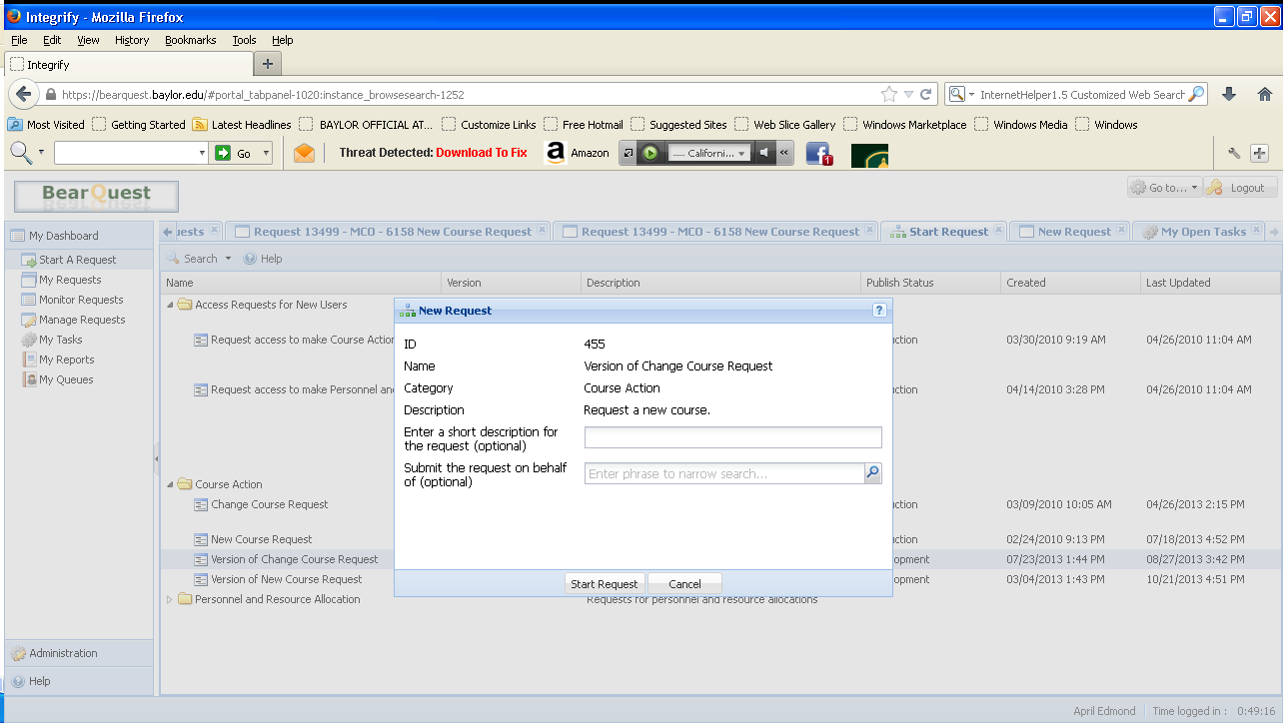
New Course Request : Start Request
To begin a new course request, click on ‘start a request’ under My Dashboard, then click ‘new course request’ under Course Action. The first screen you will see asks you to enter a short description of the request (this is optional). You can also enter the name of the person of whom you are sending the request (also optional). If you choose the not enter either of these items, you can begin by clicking start request.

Slide 3
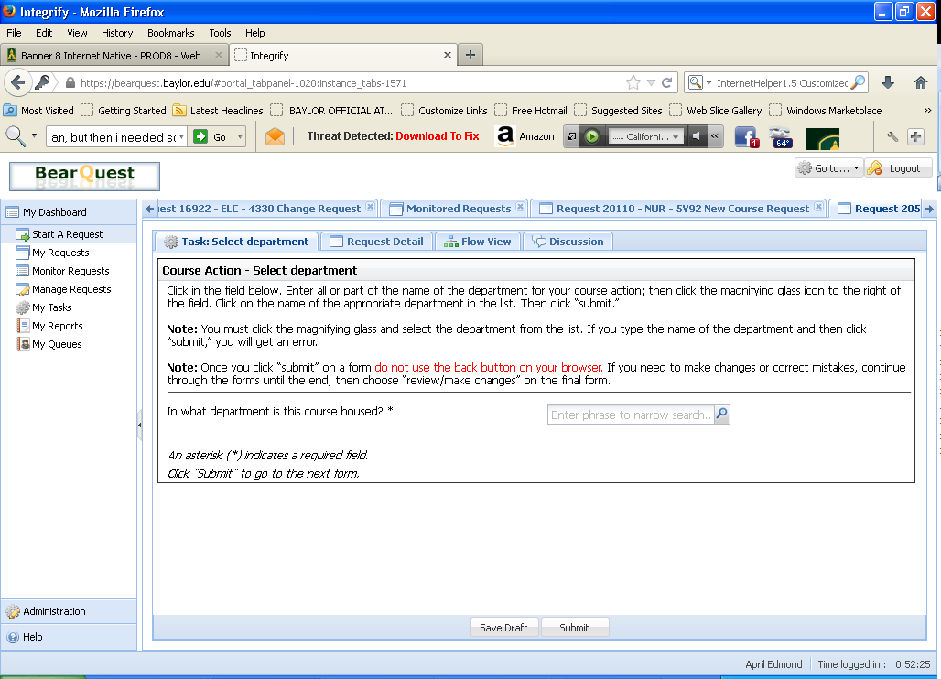
New Course Request : Select Department
To indicate the department for your new course, you will need to select that department from a list. Enter part or all of the department’s name in the field, then click on the Magnifying glass icon.
This will bring up a list of all the departments that match the letters you entered. Click on the appropriate department name.

Slide 4
New Course Request : Select Department
This will populate the field with the appropriate department name. To go on to the next form, click “Submit.”

Slide 5
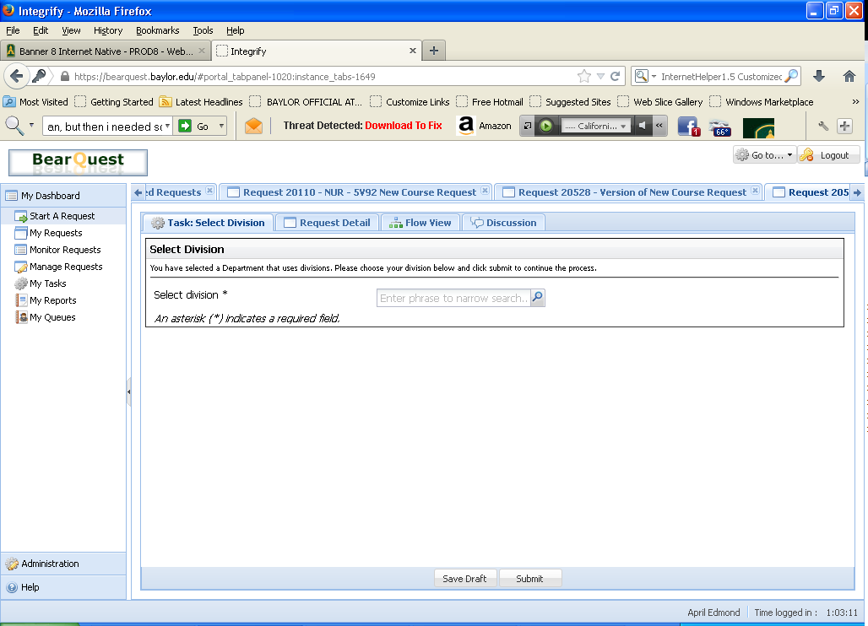
New Course Request : Select Division
If you are submitting a request for a department that uses divisions within the course catalog, you will be asked to choose the correct one on this form. Click the magnifying glass to see a list of possible choices. Then, click the appropriate division and click submit.

Slide 6
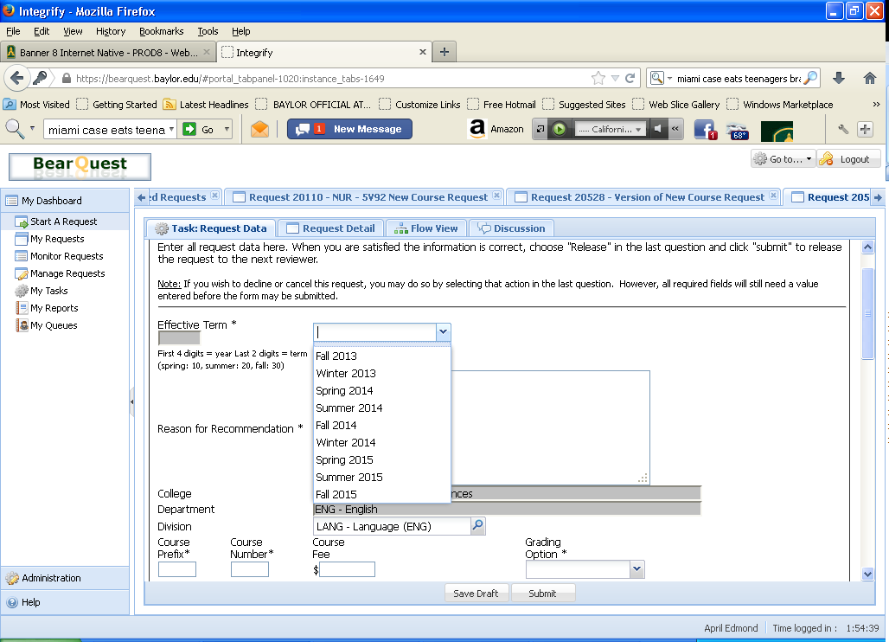
New Course Request : Effective Term
On this form you will begin by entering the effective term for your new course. The “effective term” is the term when it will be offered for registration for the first time.
Your answers from this point forward will determine what questions you will see next. For example, if you answer “yes” to the question “Can this course be taken more than once for credit?” You will be presented with an additional question that asks you how many hours of this course can be counted toward the degree.

Slide 7
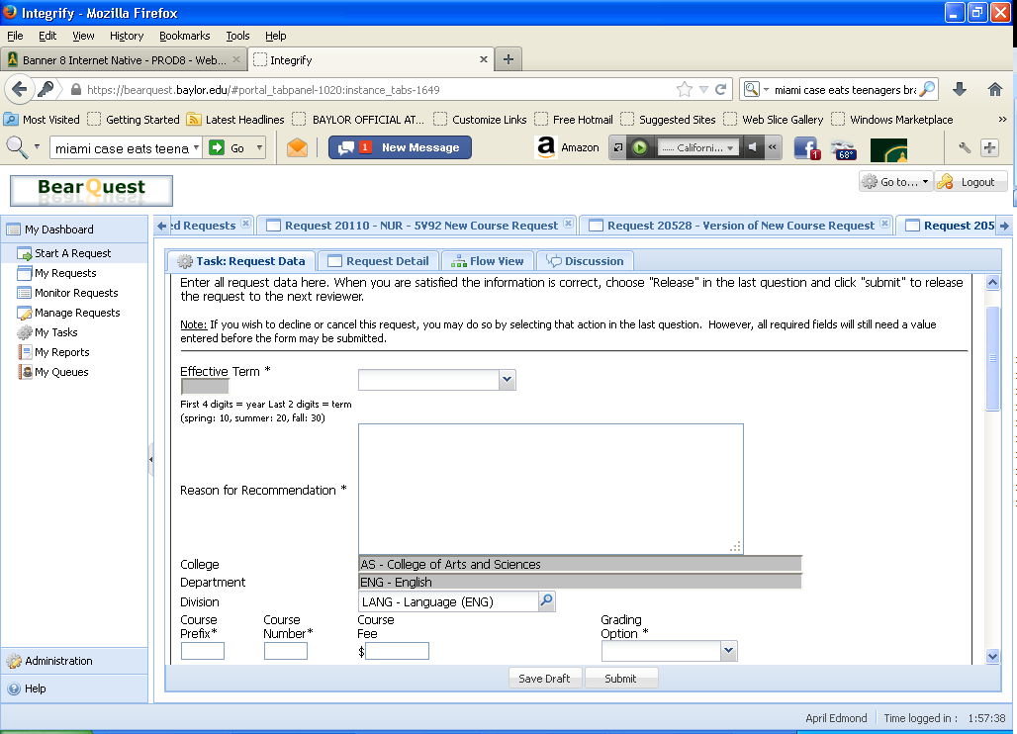
New Course Request : Request Data
This section is also where you enter the “reason for recommendation,” the course prefix, course number, course fee if applicable and the grading option.
1
2
3
4
5
The “reason for recommendation” is an explanation about why the department is choosing to add this course. The field has a 450 character limit.
The course prefix is the 2-4 letter combination related to the course you are adding.
The course number (further explanation on the next page) is a four digit number related to the course you are adding.
If applicable, this is where you would add the course fee.
The drop down menu lists the choices related to grading options for this course.

Slide 8
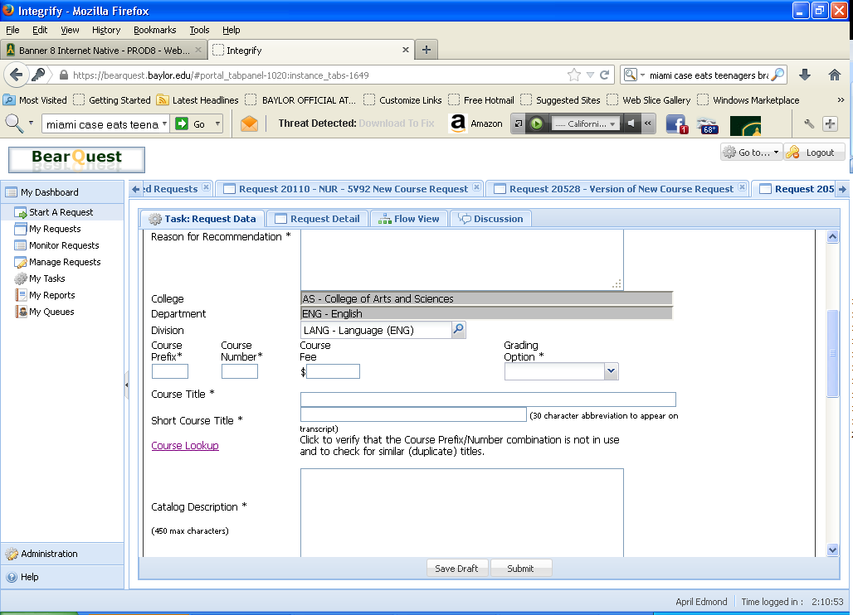
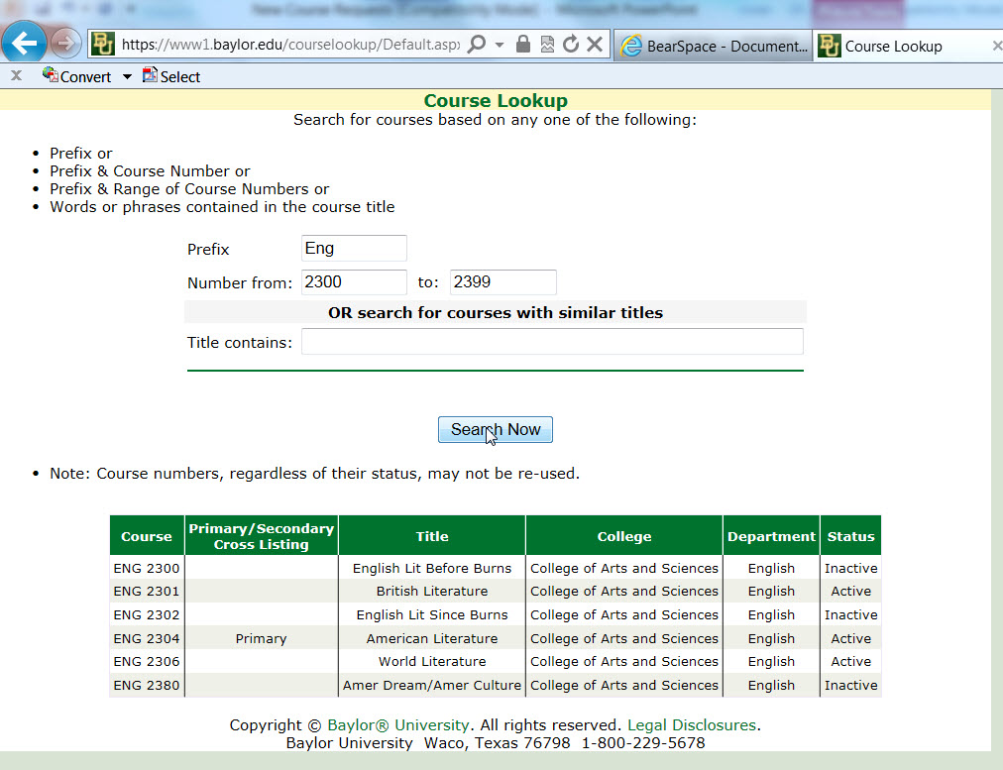
New Course Request : Course Lookup
One convenient feature of this form is the “Course Lookup” link. This link takes you to a webpage where you can search for courses that have similar names to your new course, and also make sure the course number you plan to use is available.

Slide 9
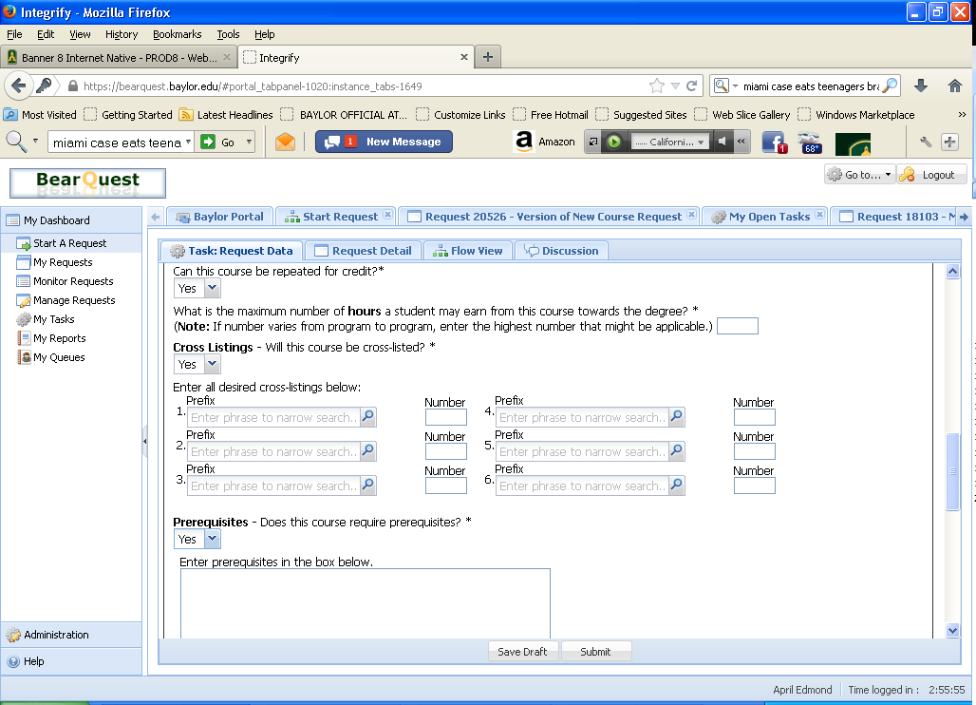
New Course Request : Additional Data
Next, you will fill in the fields for course title, short course title, and catalog description.
The full course title that will appear in the course catalog.
Please create a 30 character abbreviation of the course title that will appear on the transcript.
This is the course description as it will appear in the course catalog. There is a 450 character limit.
1
2
3
Continuing down the form, you will answer “can this course be repeated for credit,” “will this course be cross-listed,” “and “does this course require prerequisites?” If you answer yes to any of these questions, you will be prompted with an additional question. If the answer is no, choose ‘no’ from the drop down menu and continue down the form.
4. If the course can be repeated for credit, choose yes and enter the number of hours/times in the next field.
If the course is cross-listed with another course, choose yes and click on the magnifying glass to choose it from a list of courses.
If the course has prerequisites, choose yes and enter the information in the box that follows.
4
5
6

Slide 10
New Course Request : Co-requisite Data
7. If the course has a co-requisite, choose yes and enter the courses in the fields that follow.
Please note: Students will be required to register in ALL listed co-requisite courses in the same semester they are registered for your new course.

Slide 11
New Course Request : Supporting Course Data
This is the form where you attach the completed Course Data Template for your new course. You can think of “supporting course data” as similar to the kind of data you might find in a syllabus for a course. Each academic unit has different requirements about what must be included in supporting course data. To be sure you are including the correct data, download and complete the Course Data Template for your academic unit. You can find the course data templates at the weblink shown on this form. (www.baylor.edu/provost/course_data_templates)
When you have completed the Course Data Template for your new course, save it as a Word document, then use the browse button on this form to find it and attach it.
Please note: Any course that may be taken for graduate credit under the purview of the Graduate School should use the Graduate School Course Data Template.
To attach the completed course data template, click on the notepad icon next to the field.
When you see this “upload file” window, click on the browse button.

Slide 12
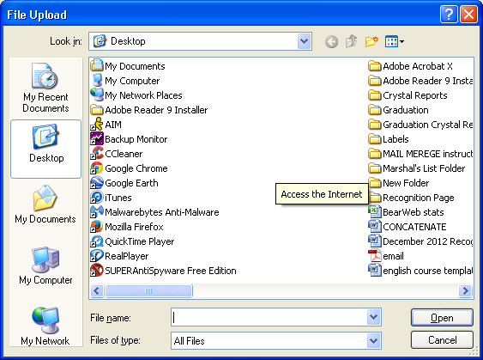
New Course Request Basic Forms: Supporting Course Data
Select the appropriate file from the list.
Then click, “upload file.” When you see that the file has uploaded, click “submit.”

Slide 13
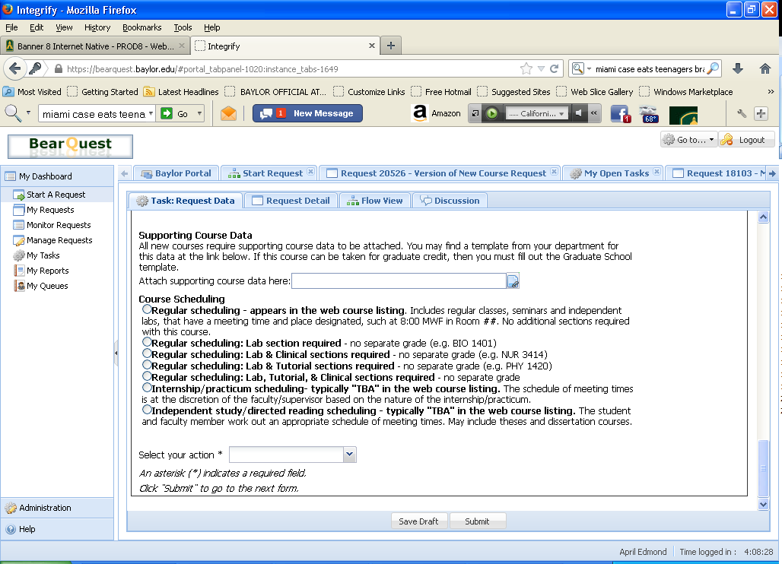
New Course Request: Scheduling
Use this form to indicate how your new course should be scheduled. Most courses will be regular scheduling, but there are several other options available including “Independent study/directed reading scheduling;” this is the type of scheduling that should be used for theses and dissertation courses.
Select the appropriate type of scheduling for your course, and click Submit.
Note: if your new course is in Music, HP/LF, Art or Theater, you will see different scheduling options. (See below for Music example).
Example of scheduling form for music:

Slide 14
New Course Request: Release or Decline/Cancel
This is the last question in the process for requesting a new course. You have the choice to release your request for review, or to decline/cancel your request.
If you select “release to next reviewer” your request will be forwarded to the first person on the review/approval path. That person will receive an email indicating that he/she has a task to do on your request.
When you have made your selection, click “Submit.”
When you release your request for review, you will get a task confirmation to let you know that your request has been successfully moved on to the next step in the process. You have completed your request for a new course.

Slide 15
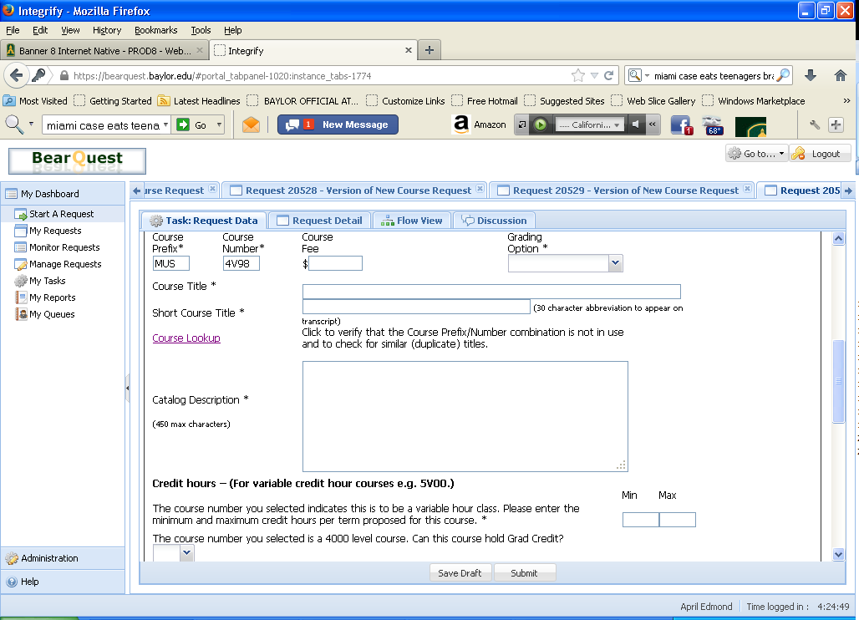
New Course Request Additional Possible Scenario:
Variable Credit Hours
Some courses have variable hours, this is usually indicated by the letter “V” in the Course number. If the course number for your new course indicates variable credit hours, you will be presented with an additional question to complete as part of the new course request process. (See below.) This question will ask you to indicate the minimum and maximum hours a student may receive per term for taking the course.

Slide 16
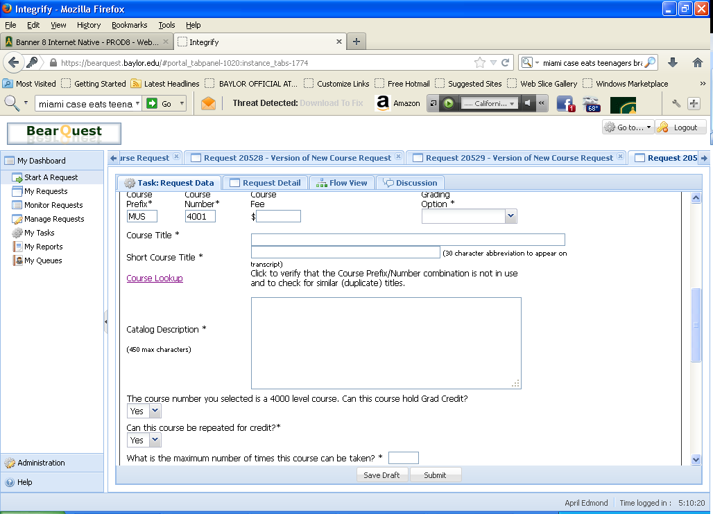
New Course Request Additional Possible Scenario:
Graduate Credit on a 4000 level course, or zero hour course
On some occasions, a 4000 level course can hold graduate credit. When the form recognizes that you have entered a 4000 level course number, an additional question will appear. If the course should hold graduate credit, choose ‘yes’ from the drop down menu; otherwise, choose ‘no.’

Slide 17
New Course Request Additional Possible Scenario:
Graduate Credit on a 4000 level course, or zero hour course
There is also the occasion that a course could be a zero hour course. In this case, the form would recognize that there would be no credit hours and it will ask you how many times the course can be repeated rather than how many hours.

